Slide 1







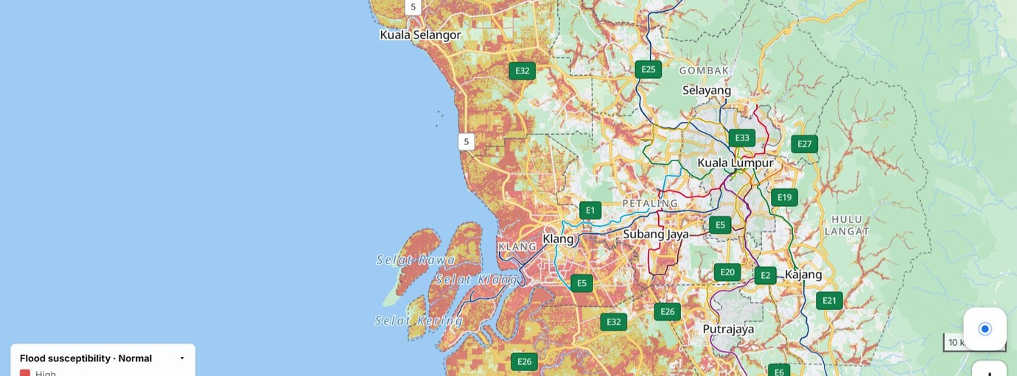
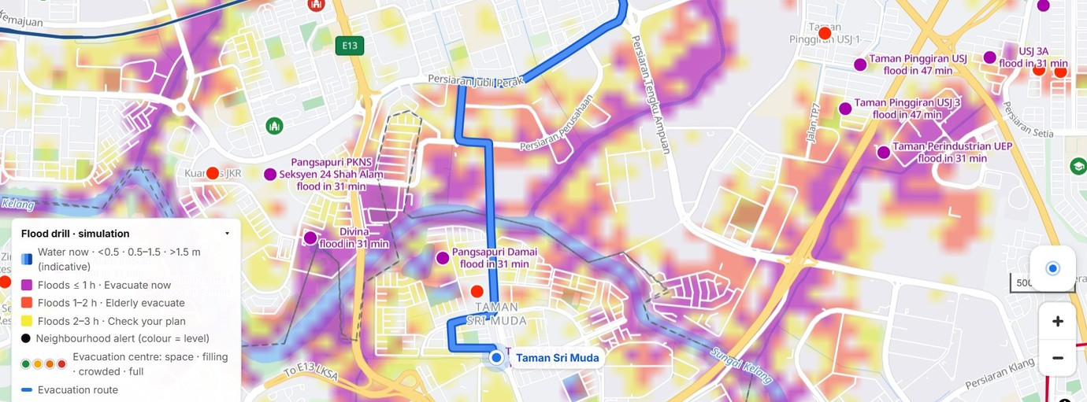
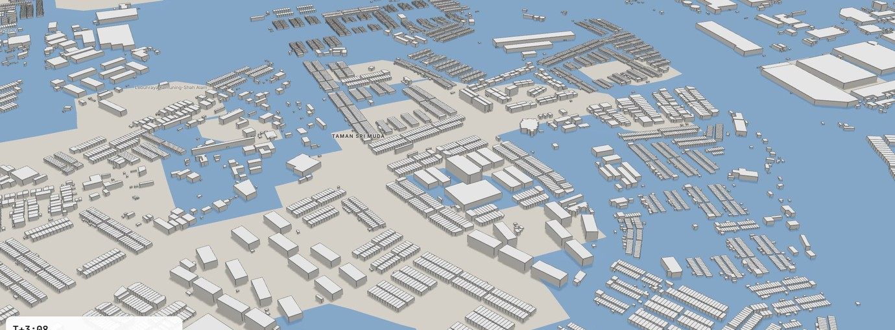

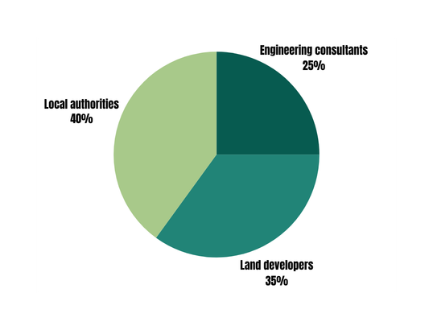
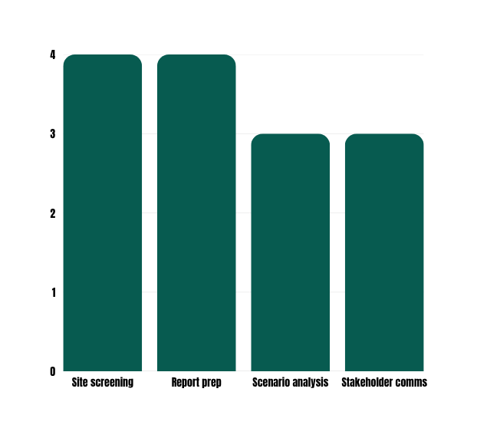
GINKGO
FLOOD COMMAND CENTER: FROM RISK MAP TO EVACUATION PLAN FOR SELANGOR
PROJECT SUPERVISOR: TS. NURZEATUL HAMIMAH BINTI ABDUL HAMID
PREPARED BY MUHAMMAD LUQMAN NURHAKIM BIN ROSLI, BATRISYIA AFRINA BINTI RISAMUDDIN, NADYIE AZIL BIN NAZERI
INSTITUTION: FACULTY OF COMPUTER AND MATHEMATICAL SCIENCES, UNIVERSITI TEKNOLOGI MARA |
URBIEE NO.: BST03 | CATEGORY B UITM STUDENTS
ABSTRACT
OBJECTIVE
When floods come, people hear that a warning is in force, but not when to leave or where to go, and nobody can see which shelters will fill up. Ginkgo is a web-based flood command center for Selangor's nine districts that closes this gap.
Planning mode maps where river flooding is most likely, from satellite terrain, rivers, 38 years of surface-water records and census data on a grid of about 92 m cells. Flood drill mode then replays a storm hour by hour: it warns each neighbourhood on Japan's five-level scale, finds a walking or driving route along roads that stay dry to a centre that still has space, and says when to leave. A 3D model of Taman Sri Muda shows the water on the street, and an AI assistant answers in English or Malay with every figure checked against the data.
It runs in a browser on open data (Copernicus, OpenStreetMap, JRC, ESA, Meta, DOSM), so no GIS software is needed. The drill is a simulation for rehearsal, not a forecast.
  Map where river flooding is most likely in Selangor under Normal, Heavy and Extreme rain, in a form anyone can read
  Rehearse a flood hour by hour, with alerts on Japan's five-level scale and a one-hour look-ahead for each neighbourhood
  Guide each household along a dry route to an evacuation centre that still has space, and say when to leave
  Show the water on the street in 3D, and let anyone ask in English or Malay with every number checked against the data
24.1%
~1.93M
1,274
of Selangor's land has High flood susceptibility
people live on land at High risk (estimate)
candidate evacuation centres, each with a capacity
USEFULNESS & COMMERCIALISATION POTENTIAL
  Turns open satellite and census data into a risk map, a drill and routes that anyone can use
RISK BY DISTRICT
THE EVACUATION GAP
High and Moderate share of land
Klang storm drill, people (thousands)
  Gives each household a dry route, a centre with space and a leave-by time
  Open data and a browser app keep costs low: an AI answer is a few US cents, repeats are free
  Next: a council pilot on live river gauges, then Malaysia and ASEAN
Source: Ginkgo analysis of open data
Source: Ginkgo flood drill, Extreme rain (estimate)
SYSTEM IN ACTION
1 MAP Where river flooding is most likely
2 DRILL Alert, dry route, centre with space
3 3D The water on the street
CONCLUSION
Ginkgo turns a flood map into a plan: when each neighbourhood must leave, where there is space, and how to get there on dry roads. Checked against 7 reported December 2021 flood sites (4 flagged High, 2 of 2 hilly controls Low). A simulation for rehearsal, not a forecast.

